Slide 1
Graphs
Dr. Muhammad Amjad Iqbal

Slide 2
Introduction to Graph Data Structure
Applications
Graph Searching
Minimum Spanning Trees
Shortest Path problems

Slide 3
Graph Definitions
A graph G is denoted by G = (V, E) where
  V is the set of vertices or nodes of the graph
  E is the set of edges or arcs connecting the vertices in V
Each edge E is denoted as a pair (v,w) where v,w ε V
For example in the graph below
2
V = {1, 2, 3, 4, 5, 6}
E = {(1, 2) (2, 5) (3, 6) (4, 6) (5, 6)}
This is an example of an unordered or undirected graph
1
3
6
4
5

Slide 4
Graph Definitions (contd.)
If the pair of vertices is ordered then the graph is a directed graph or a di-graph
2
1
3
Here,
V = {1, 2, 3, 4, 5, 6}
E = {(1, 2) (2, 5) (5, 6) (6, 3) (6, 4)}
6
4
5
Vertex v is adjacent to w iff (v,w) ε E
Sometimes an edge has another component called a weight or cost. If the weight is absent it is assumed to be 1

Slide 5
Adjacency List Example
2
2
1
2
3
4
5
6
1
3
5
6
4
6
5
3
4
Graph
Adjacency List
An adjacency list for a weighted graph should contain two elements in the list nodes – one element for the vertex and the second element for the weight of that edge

Slide 6
Representing Graphs: Adjacency List
Adjacency List
  Array of lists
  Each vertex has an array entry
  A vertex w is inserted in the list for vertex v if there is an outgoing edge from v to w
  Space requirement = Θ(E+V)
  Sometimes, a hash-table of lists is used to implement the adjacency list when the vertices are identified by a name (string) instead of an integer

Slide 7
Representing Graphs: Adjacency Matrix
Adjacency Matrix
  Two dimensional matrix of size n x n where n is the number of vertices in the graph
  a[i, j] = 0 if there is no edge between vertices i and j
  a[i, j] = 1 if there is an edge between vertices i and j
  Undirected graphs have both a[i, j] and a[j, i] = 1 if there is an edge between vertices i and j
  a[i. j] = weight for weighted graphs
Space requirement is Θ(N²)
Problem: The array is very sparsely populated. For example if a directed graph has 4 vertices and 3 edges, the adjacency matrix has 16 cells only 3 of which are 1
For weighted graphs, a[i,j] = weight of edge between vertices i and j

Slide 8
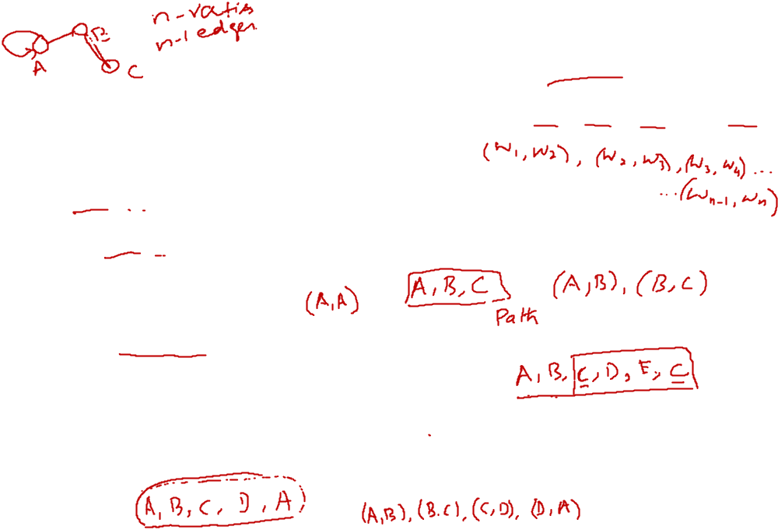
Graph Definitions: Path
A path is a sequence of vertices w₁, w₂, w₃, ....w_{n} such that (w_{i}, w_{i+1}) ε E
Length of a path = # edges in the path
A loop is an edge from a vertex onto itself. It is denoted by (v, v)
A simple path is a path where no vertices are repeated along the path
A cycle is a path with at least one edge such that the first and last vertices are the same, i.e. w₁ = w_{n}

Slide 9
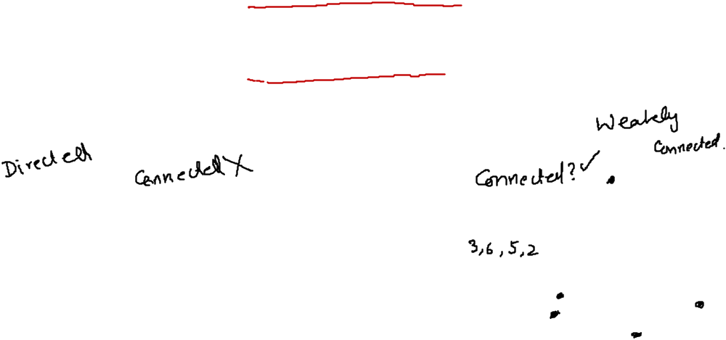
Graph Definitions: Connectedness
A graph is said to be connected if there is a path from every vertex to every other vertex
A connected graph is strongly connected if it is a connected graph as well as a directed graph
A connected graph is weakly connected if it is
  a directed graph that is not strongly connected, but,
  the underlying undirected graph is connected
2
2
1
3
1
3
Strong or Weak?
6
4
6
4
5
5

Slide 10
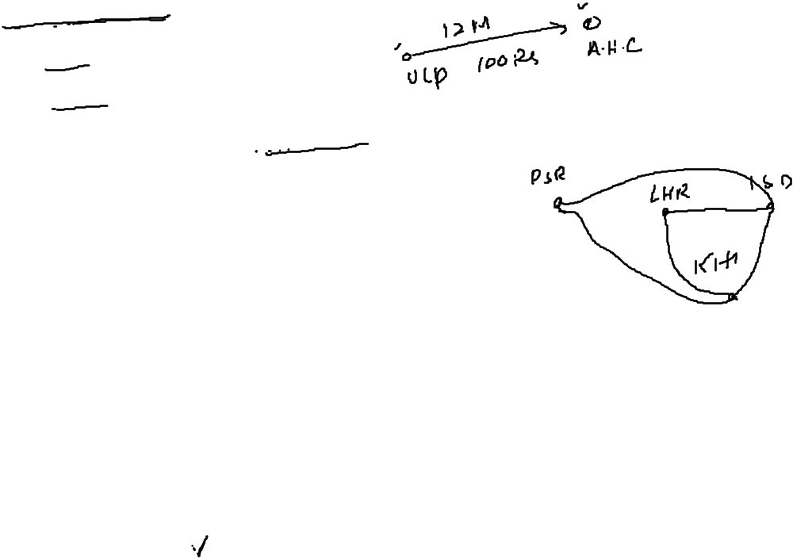
Applications of Graphs
Driving Map
  Edge = Road
  Vertex = Intersection
  Edge weight = Time required to cover the road
Airline Traffic
  Vertex = Cities serviced by the airline
  Edge = Flight exists between two cities
  Edge weight = Flight time or flight cost or both
Computer networks
  Vertex = Server nodes
  Edge = Data link
  Edge weight = Connection speed
CAD/VLSI

Slide 11

Graphs Searching

Slide 12
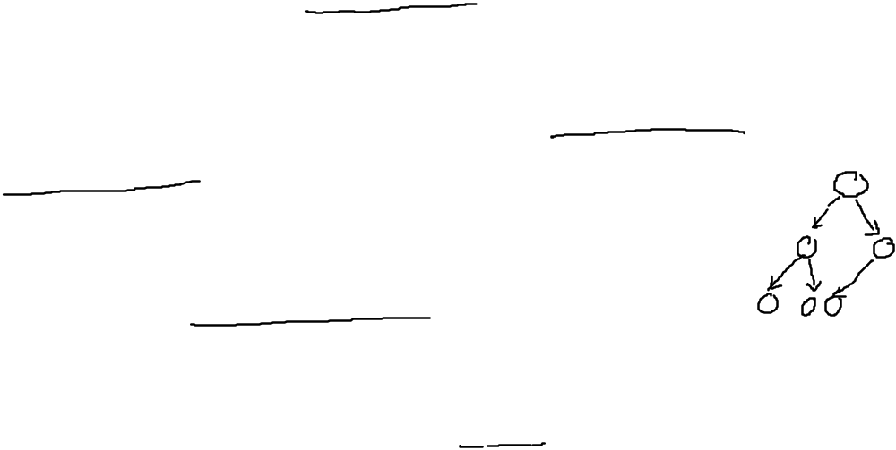
Graph Searching
Given: a graph G = (V, E), directed or undirected
Goal: methodically explore every vertex and every edge
Ultimately: build a tree on the graph
  Pick a vertex as the root
  Choose certain edges to produce a tree
  Note: might also build a forest if graph is not connected

Slide 13


Depth First Search
Depth-first search: Strategy
Go as deep as can visiting un-visited nodes
Choose any un-visited vertex when you have a choice
When stuck at a dead-end, backtrack as little as
possible
Back up to where you could go to another unvisited vertex
Then continue to go on from that point
Eventually you’ll return to where you started

Slide 14
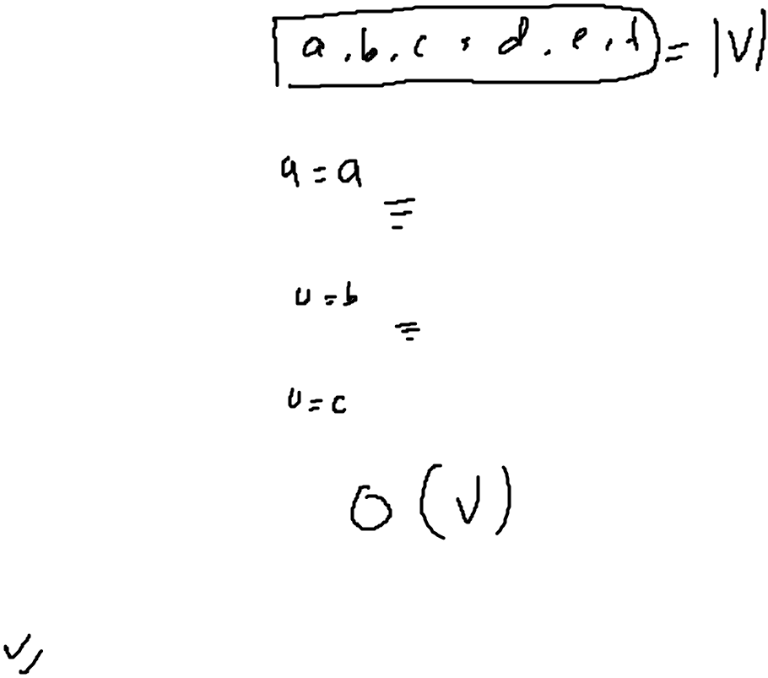
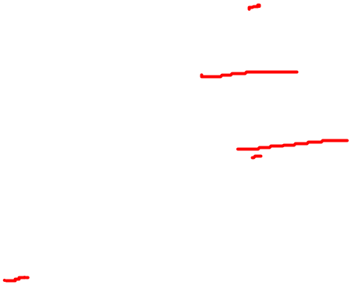
DFS Algorithm
DFS(G)
for each vertex u ∈V[G] {
color[u]=white
parent[u]=NULL
}
time=0
for each vertex u ∈V[G] {
if color[u]=white then
DFS-VISIT(u)
}

Slide 15
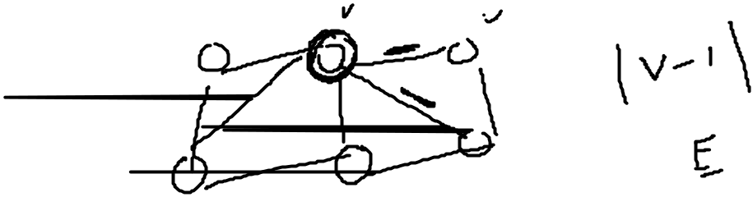
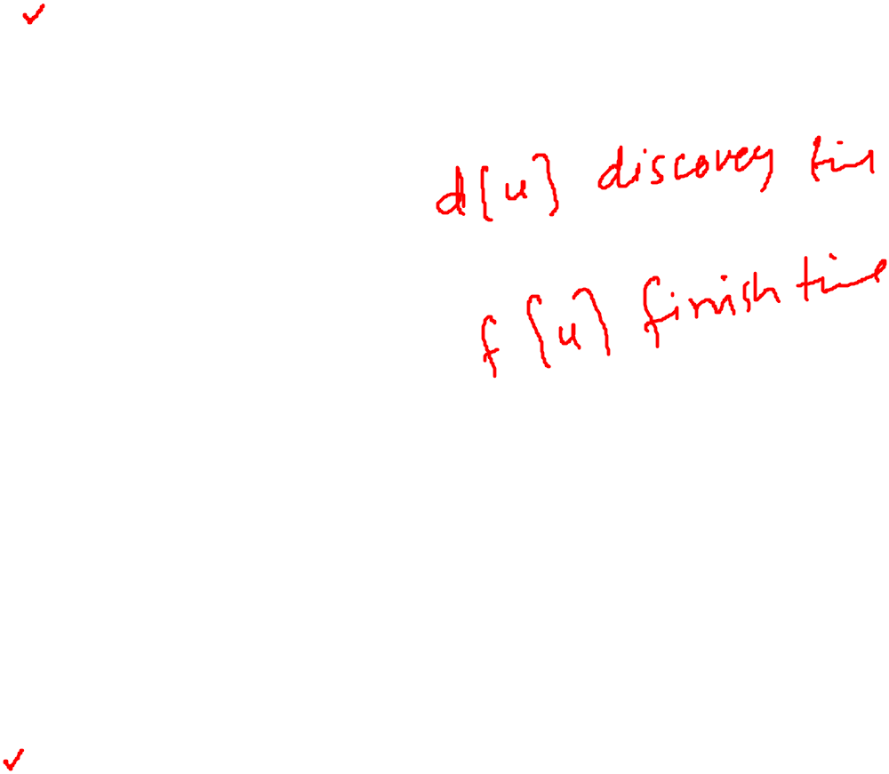
DFS-VISIT(u)
color[u]=GRAY
time=time+1
d[u]=time
for each vertex v ∈ adj[u] {
if color[v]=white Then
parent[v]=u
DFS-VISIT(v)
}
color[u]=black
f[u]=time=time+1

Slide 16
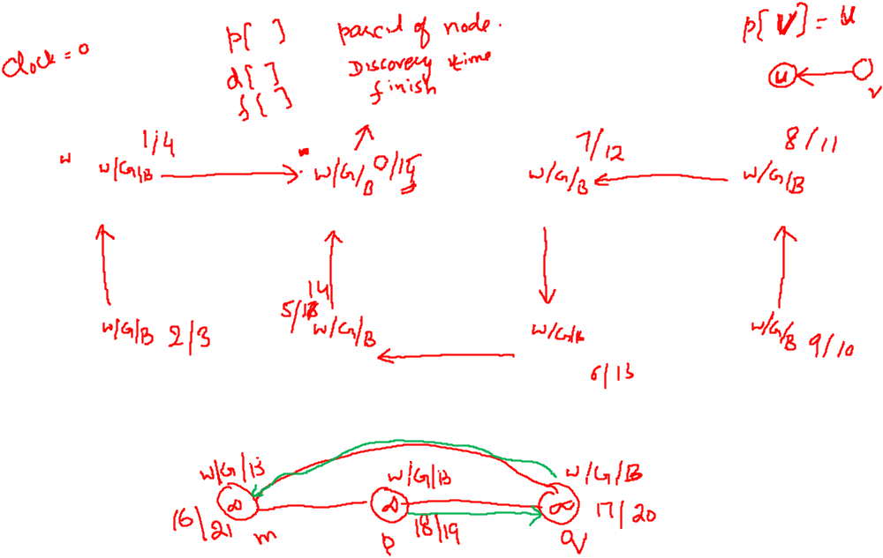

Depth-First Search: Example
r
s
t
u
∞
∞
∞
∞
∞
∞
∞
∞
v
w
x
y

Slide 17
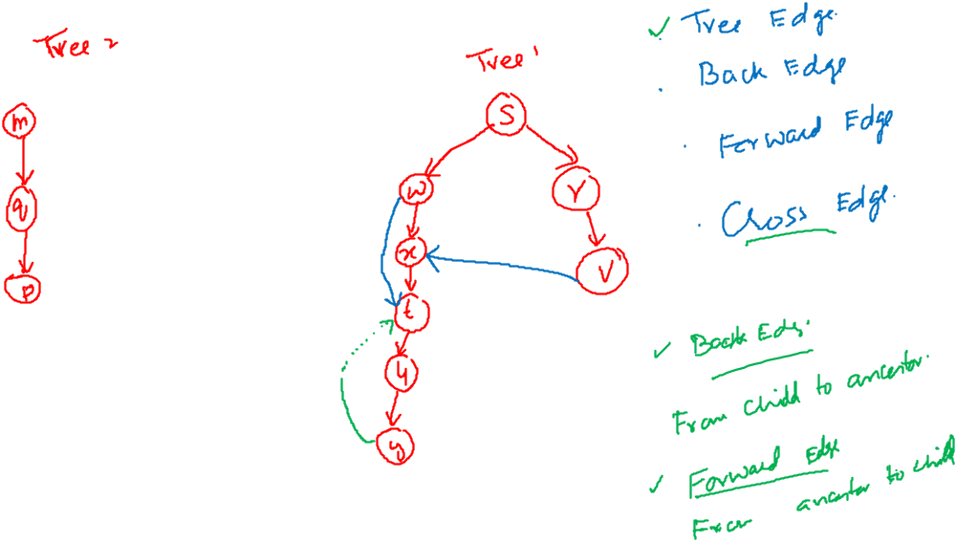
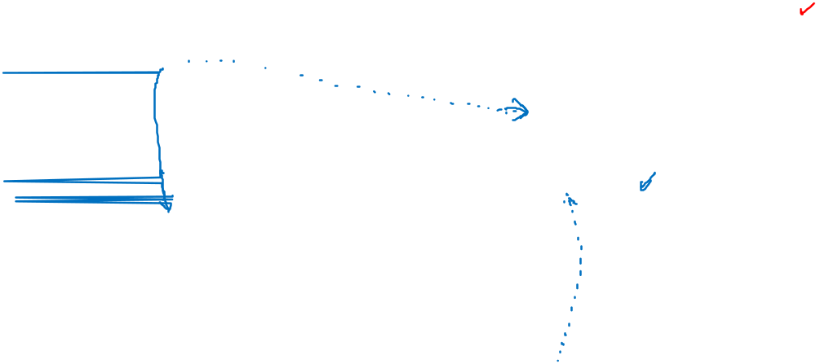


Slide 18
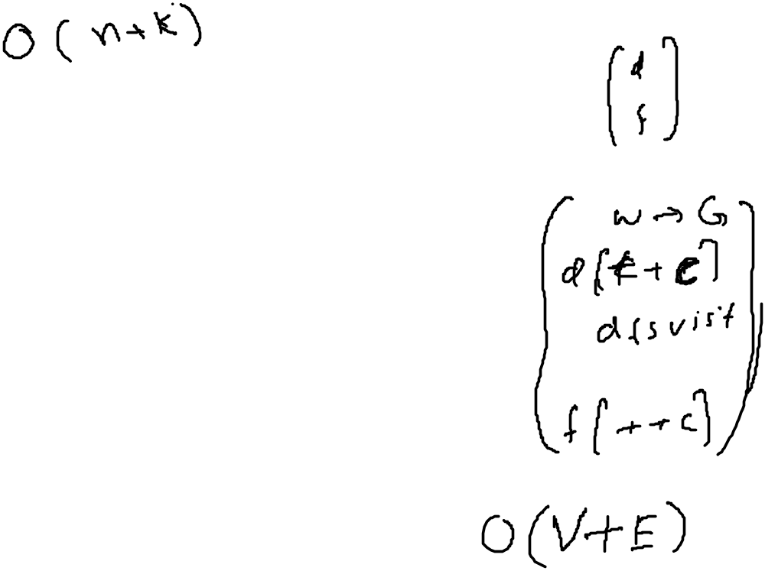
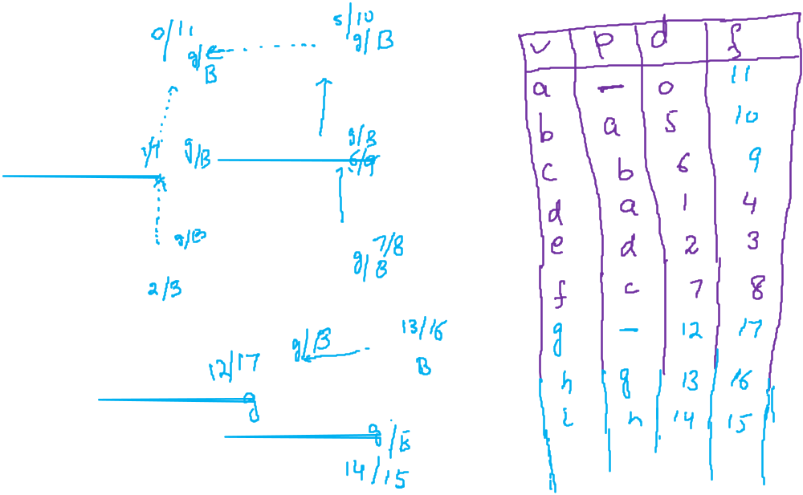
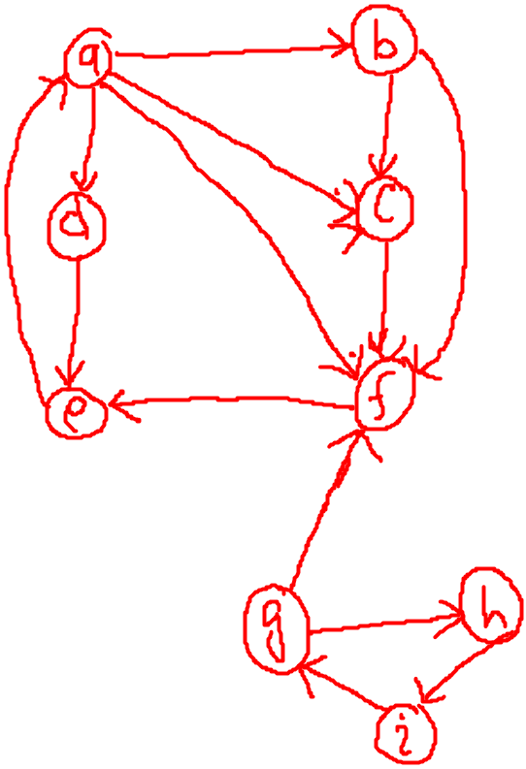

Slide 19
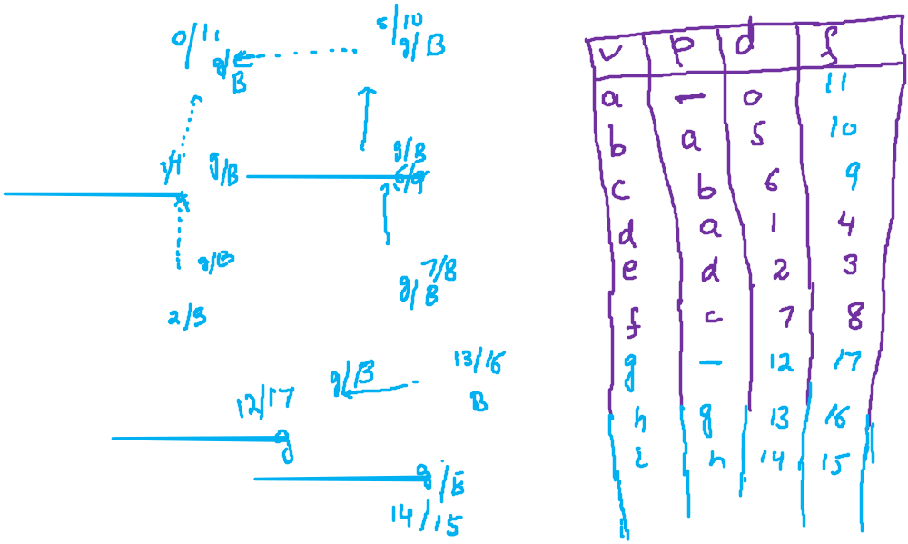
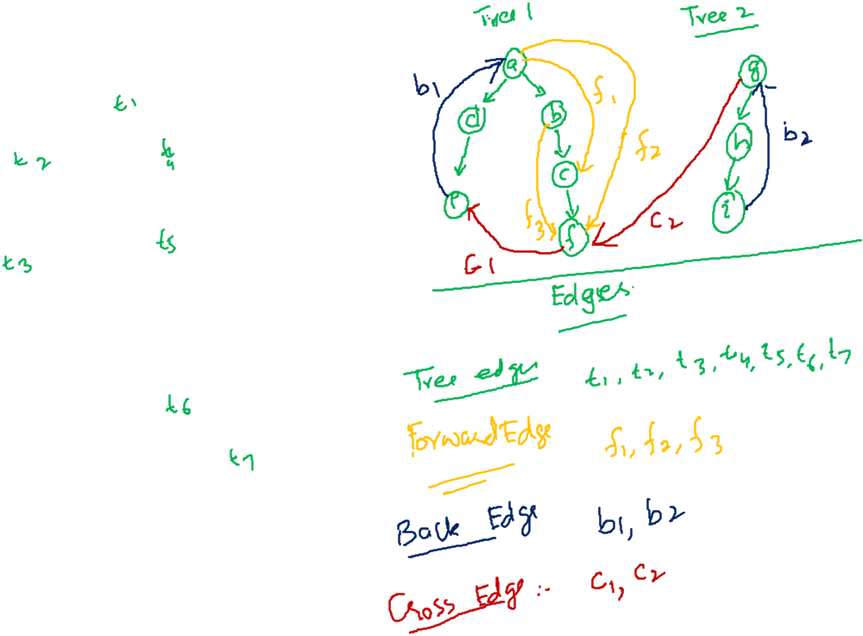

Slide 20
Types of Edges
Back edges point from a node to one of its ancestors in the DFS tree.
Forward edges point from a node to one of its descendants.
Cross edges point from a node to a previously visited node that is neither an ancestor nor a descendant.
Edge type of uv | start times | end times
Tree edge | d[u] < d[v] | f[u] > f[v]
Back edge | d[u] > d[v] | f[u] < f[v]
Forward edge | d[u] < d[v] | f[u] > f[v]
Cross edge | d[u] > d[v] | f[u] > f[v]

Slide 21
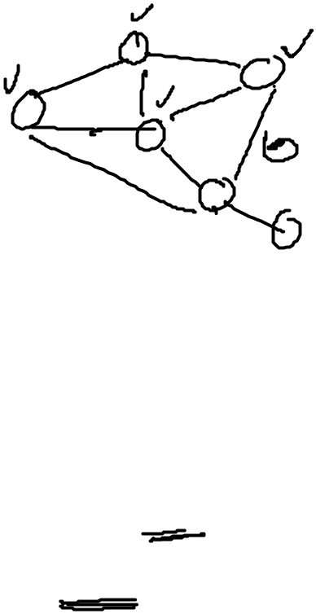
Breadth-First Search
Given a G=(V,E) and distinguished source vertex s, BFS systematically explores the edges of G to “discover” every vertex reachable from s.
Creates a BFS tree rooted at s that contains all such vertices.
Expands the frontier between discovered and undiscovered vertices uniformly across the breadth of the frontier.
The algorithm discovers all vertices at distance k from s before discovering any vertices at distance k+1

Slide 22
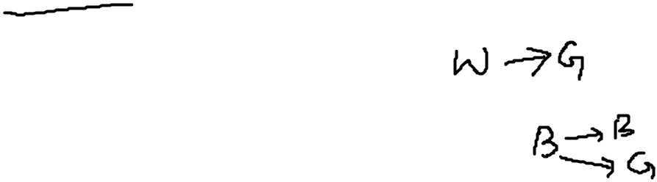
Breadth-First Search
will associate vertex “colors” to guide the algorithm
  White vertices have not been discovered
    All vertices start out white
  Grey vertices are discovered but not fully explored
    They may be adjacent to white vertices and represent the frontier between the discovered and the undiscovered.
  Black vertices are discovered and fully explored
    They are adjacent only to black and gray vertices
Explore vertices by scanning adjacency list of grey vertices

Slide 23
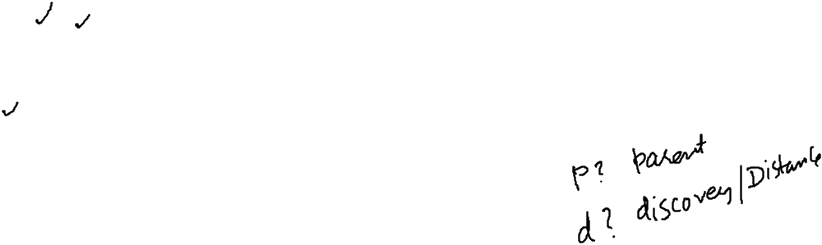
Breadth-First Search
BFS(G, s) {
initialize vertices;
Q = {s}; // Q is a queue initialize to s
while (Q not empty) {
u = Dequeue(Q);
for each v ∈ u->adj {
if (v->color == WHITE){
v->color = GREY;
v->d = u->d + 1;
v->p = u;
Enqueue(Q, v);
}
}
u->color = BLACK;
}
}
What does v->d represent?
What does v->p represent?

Slide 24

Breadth-First Search: Example
r
s
t
u
∞
∞
∞
∞
∞
∞
∞
∞
v
w
x
y

Slide 25
Breadth-First Search: Example
r
s
t
u
∞
0
∞
∞
∞
∞
∞
∞
v
w
x
y
Q:
s

Slide 26
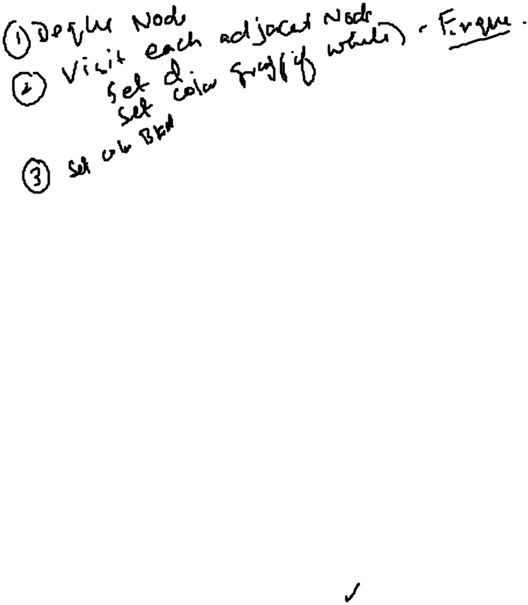
Breadth-First Search: Example
r
s
t
u
1
0
∞
∞
∞
1
∞
∞
v
w
x
y
Q:
w
r

Slide 27
Breadth-First Search: Example
r
s
t
u
1
0
2
∞
∞
1
2
∞
v
w
x
y
Q:
r
t
x

Slide 28
Breadth-First Search: Example
r
s
t
u
1
0
2
∞
2
1
2
∞
v
w
x
y
Q:
t
x
v

Slide 29
Breadth-First Search: Example
r
s
t
u
1
0
2
3
2
1
2
∞
v
w
x
y
Q:
x
v
u

Slide 30
Breadth-First Search: Example
r
s
t
u
1
0
2
3
2
1
2
3
v
w
x
y
Q:
v
u
y

Slide 31
Breadth-First Search: Example
r
s
t
u
1
0
2
3
2
1
2
3
v
w
x
y
Q:
u
y

Slide 32
Breadth-First Search: Example
r
s
t
u
1
0
2
3
2
1
2
3
v
w
x
y
Q:
y

Slide 33
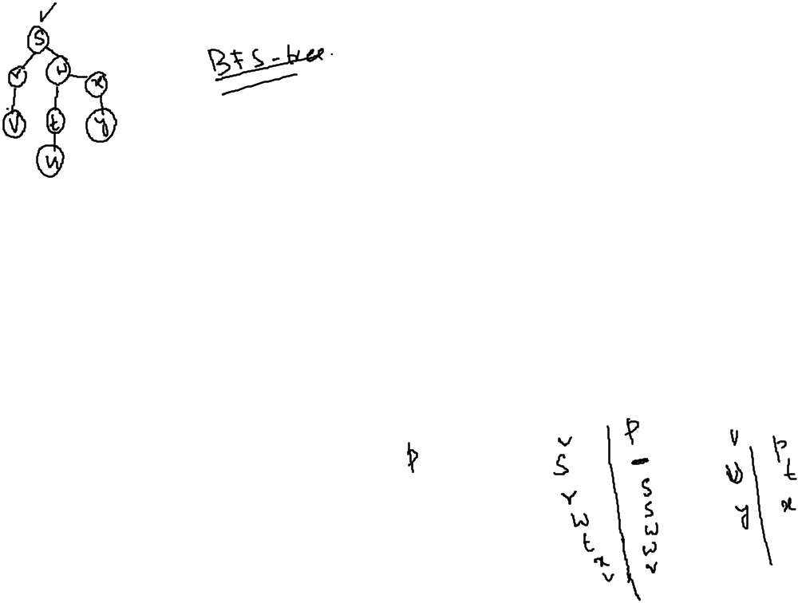
Breadth-First Search: Example
r
s
t
u
1
0
2
3
2
1
2
3
v
w
x
y
Q:
Ø

Slide 34
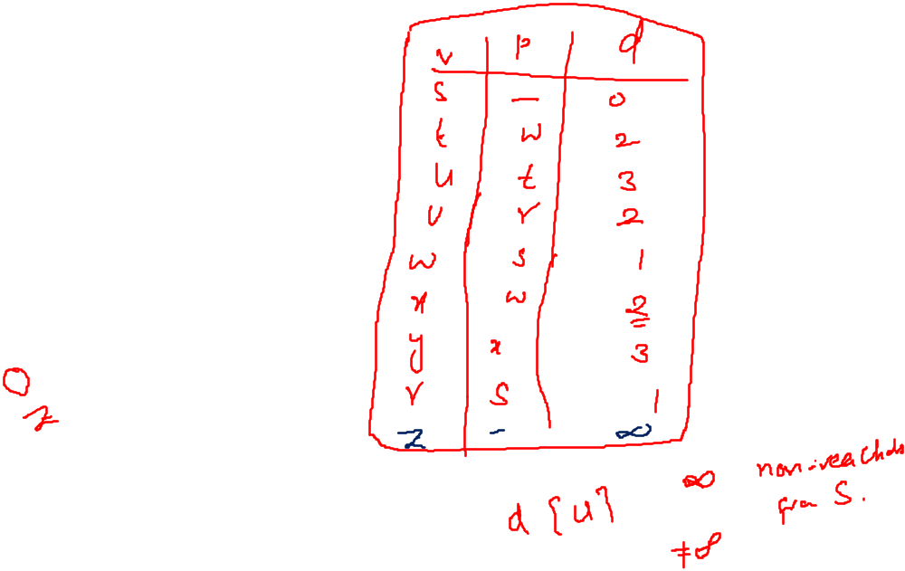
Breadth-First Search: Example
r
s
t
u
1
0
2
3
2
1
2
3
v
w
x
y
Q:
Ø

Slide 35
Breadth-First Search: Properties
BFS calculates the shortest-path distance to the source node
  Shortest-path distance δ(s,v) = minimum number of edges from s to v, or ∞ if v not reachable from s
BFS builds breadth-first tree, in which paths to root represent shortest paths in G
  Thus can use BFS to calculate shortest path from one vertex to another in O(V+E) time

Slide 36
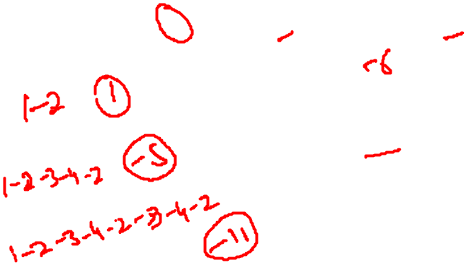
Negative Cost Cycle
A negative cost cycle is a cycle such that the sum of the costs of the edges is negative
The more we cycle through a negative cost cycle, the lower the cost of the cycle becomes
1
Cost of the path v₁-v₅
  No traversal of cycle: 6
  One traversal of cycle: 0
  Two traversals of cycle: -6
  Three traversals of cycle: -12
  ...
1
4
3
2
2
4
-12
5
5
Negative cost cycles are not allowed when we traverse a graph to find the weighted shortest path

Slide 37
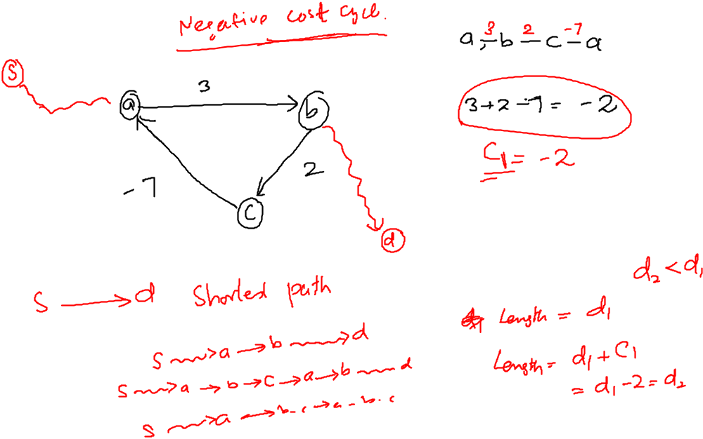

Slide 38
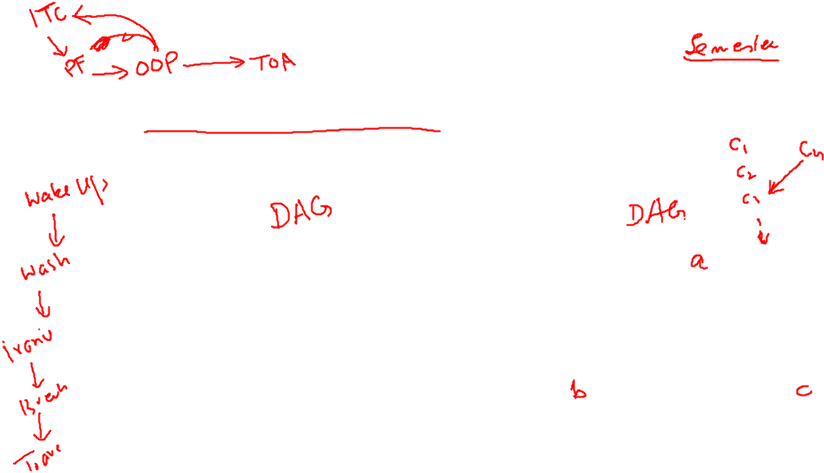
Directed Acyclic Graphs
A directed acyclic graph or DAG is a directed graph with no directed cycles:

Slide 39
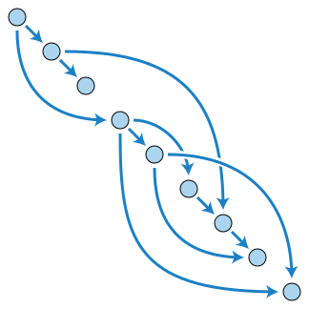
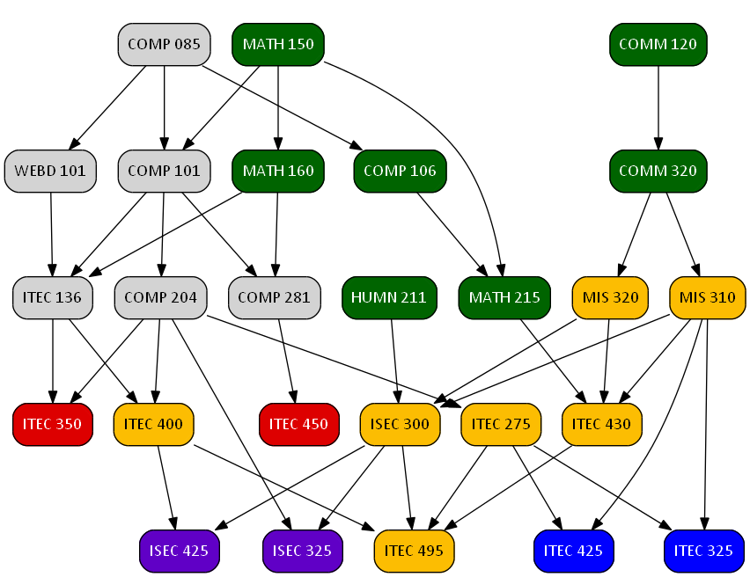
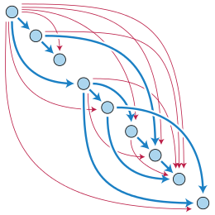
Directed Acyclic Graphs

Slide 40
A graph having no cycle is called Acyclic Graph. Graph can be directed or undirected.
Any undirected graph can be called Undirected Acyclic Graph? Is this possible? In what case?
A directed graph having no cycles is called Directed Acyclic Graph.
How can we check that a given graph is Directed Acyclic Graph. If we can find out that the given graph has no cycles.
How can we check that there is cycle or not in the graph.
Can DFS help us in this regard? [How DFS can find, there is a cycle or not]

Slide 41
Graph Sort Orders
A sort order is just some ordering of the nodes in a graph.
We have seen:
  BFS ordering – in order of (some) BFS traversal from A
  DFS ordering – in order of (some) DFS traversal from A
  Minimum path ordering – in order of min distance to A
A more flexible ordering is possible for directed graphs…

Slide 42
Graph Sort Orders
A sort order is just some ordering of the nodes in a graph.
We have seen:
  BFS ordering – in order of (some) BFS traversal from A
  DFS ordering – in order of (some) DFS traversal from A
A more flexible ordering is possible for directed graphs…

Slide 43
Topological Sort
Want to “sort” a directed acyclic graph (DAG).
A
B
D
C
E
A
B
C
D
E
Think of original DAG as a partial order.
Want a total order that extends this partial order.

Slide 44
Topological Sort
Directed graph G.
Rule: if there is an edge u → v, then u must come before v.
Ex:
A
B
A
B
G
G
F
C
F
C
I
H
I
H
E
D
E
D

Slide 45
Topological Sort
Performed on a DAG.
Linear ordering of the vertices of G such that if (u, v) ∈ E, then u appears somewhere before v.
Topological-Sort (G)
call DFS(G) to compute finishing times f [v] for all v ∈ V
as each vertex is finished, insert it onto the front of a linked list
return the linked list of vertices
Time: Θ(V + E).

Slide 46
Example
A
B
D
1/
C
E
Linked List:

Slide 47
Example
A
B
D
1/
2/
C
E
Linked List:

Slide 48
Example
A
B
D
1/
2/3
C
E
Linked List:
2/3
E

Slide 49
Example
A
B
D
1/4
2/3
C
E
Linked List:
1/4
2/3
D
E

Slide 50
Example
A
B
D
5/
1/4
2/3
C
E
Linked List:
1/4
2/3
D
E

Slide 51
Example
A
B
D
5/
1/4
6/
2/3
C
E
Linked List:
1/4
2/3
D
E

Slide 52
Example
A
B
D
5/
1/4
6/7
2/3
C
E
Linked List:
6/7
1/4
2/3
C
D
E

Slide 53
Example
A
B
D
5/8
1/4
6/7
2/3
C
E
Linked List:
5/8
6/7
1/4
2/3
B
C
D
E

Slide 54
Example
A
B
D
9/
5/8
1/4
6/7
2/3
C
E
Linked List:
5/8
6/7
1/4
2/3
B
C
D
E

Slide 55
Example
A
B
D
9/10
5/8
1/4
6/7
2/3
C
E
Linked List:
9/10
5/8
6/7
1/4
2/3
A
B
C
D
E

Slide 56
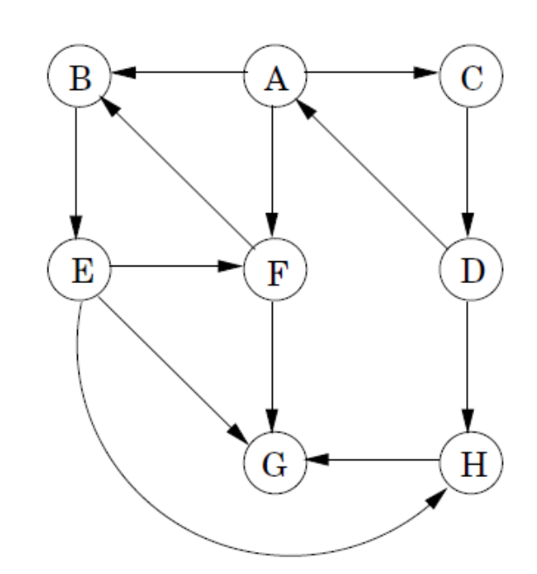
How to remove back edges
Run DFS on this graph
Mark all the vertices with discovery time and finish time
As you have marked finish time throw this vertex into the stack
As DFS ends you will have the vertices in an order that is finish time specific
A vertex having the maximum finish time will be at the top of the stack

Slide 57
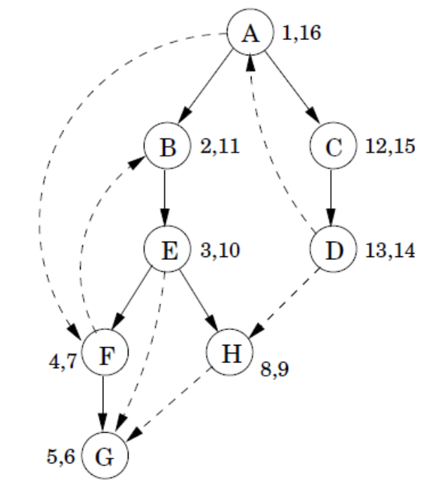
How to remove back edges
As all the vertices are in stack mark all as true.
Remove all the vertices from the stack one by one until not empty
When you remove a vertex from stack mark it false
Check all the vertices connected to this vertex
If a vertex is mark true this edge between these two is safe or if vertex is mark false then this edge is not safe remove this edge
A (1, 16)
C (12, 15)
D (13, 14)
B (2, 11)
E (3, 10)
H (8, 9)
F (4, 7)
G (5,6)
A | B | C | D | E | F | G | H
T | T | T | T | T | T | T | T

Slide 58
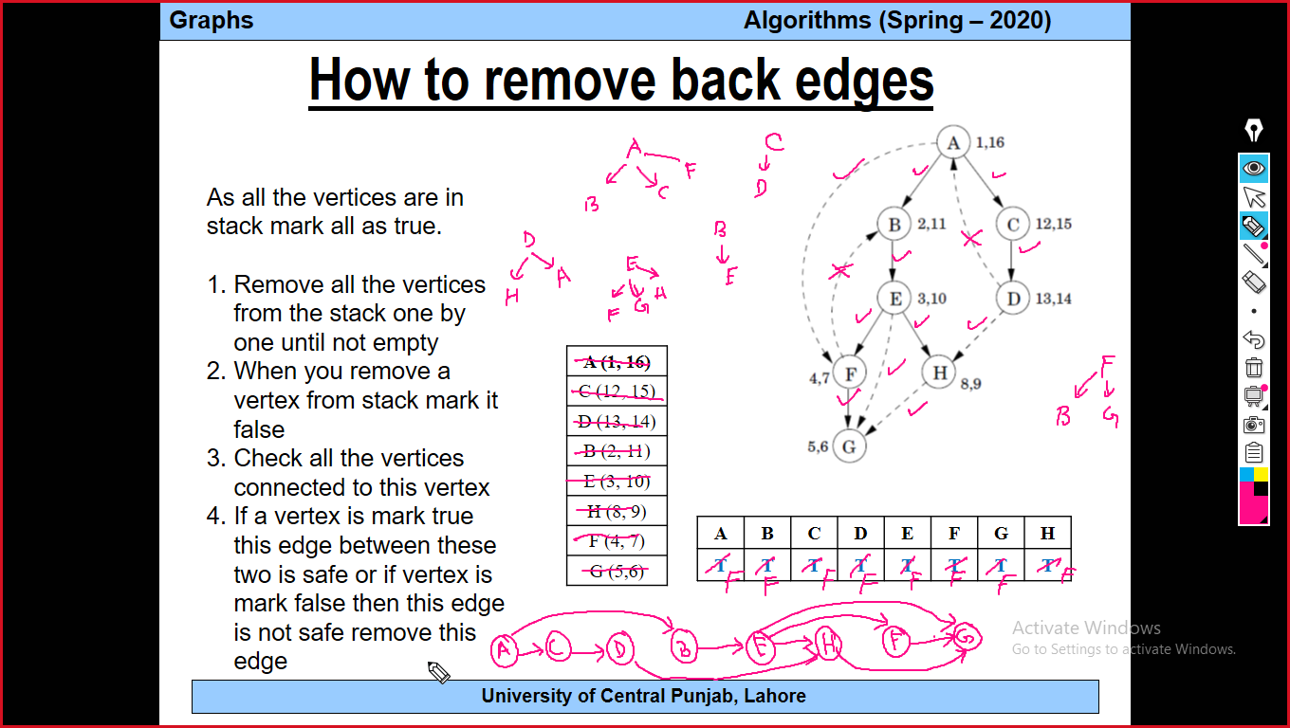

Slide 59
How to remove back edges
As all the vertices are in stack mark all as true.
Remove all the vertices from the stack one by one until not empty
When you remove a vertex from stack mark it false
Check all the vertices connected to this vertex
If a vertex is mark true this edge between these two is safe or if vertex is mark false then this edge is not safe remove this edge
C (12, 15)
D (13, 14)
B (2, 11)
E (3, 10)
H (8, 9)
F (4, 7)
G (5,6)
A → B, C, F
All are still in stack so these edges are safe
A | B | C | D | E | F | G | H
F | T | T | T | T | T | T | T

Slide 60
How to remove back edges
As all the vertices are in stack mark all as true.
Remove all the vertices from the stack one by one until not empty
When you remove a vertex from stack mark it false
Check all the vertices connected to this vertex
If a vertex is mark true this edge between these two is safe or if vertex is mark false then this edge is not safe remove this edge
D (13, 14)
B (2, 11)
E (3, 10)
H (8, 9)
F (4, 7)
G (5,6)
A | B | C | D | E | F | G | H
F | T | F | T | T | T | T | T
C → D
D is in stack so this edge is safe

Slide 61
How to remove back edges
As all the vertices are in stack mark all as true.
Remove all the vertices from the stack one by one until not empty
When you remove a vertex from stack mark it false
Check all the vertices connected to this vertex
If a vertex is mark true this edge between these two is safe or if vertex is mark false then this edge is not safe remove this edge
B (2, 11)
E (3, 10)
H (8, 9)
F (4, 7)
G (5,6)
A | B | C | D | E | F | G | H
F | T | F | F | T | T | T | T
D → A, H
A is false not safe
H is true safe

Slide 62
How to remove back edges
As all the vertices are in stack mark all as true.
Remove all the vertices from the stack one by one until not empty
When you remove a vertex from stack mark it false
Check all the vertices connected to this vertex
If a vertex is mark true this edge between these two is safe or if vertex is mark false then this edge is not safe remove this edge
E (3, 10)
H (8, 9)
F (4, 7)
G (5,6)
A | B | C | D | E | F | G | H
F | F | F | F | T | T | T | T
B → E
E is true safe

Slide 63
How to remove back edges
As all the vertices are in stack mark all as true.
Remove all the vertices from the stack one by one until not empty
When you remove a vertex from stack mark it false
Check all the vertices connected to this vertex
If a vertex is mark true this edge between these two is safe or if vertex is mark false then this edge is not safe remove this edge
H (8, 9)
F (4, 7)
G (5,6)
A | B | C | D | E | F | G | H
F | F | F | F | F | T | T | T
E → F, G, H
All are true and safe

Slide 64
How to remove back edges
As all the vertices are in stack mark all as true.
Remove all the vertices from the stack one by one until not empty
When you remove a vertex from stack mark it false
Check all the vertices connected to this vertex
If a vertex is mark true this edge between these two is safe or if vertex is mark false then this edge is not safe remove this edge
F (4, 7)
G (5,6)
A | B | C | D | E | F | G | H
F | F | F | F | F | T | T | F
H → G
G is true and safe

Slide 65
How to remove back edges
As all the vertices are in stack mark all as true.
Remove all the vertices from the stack one by one until not empty
When you remove a vertex from stack mark it false
Check all the vertices connected to this vertex
If a vertex is mark true this edge between these two is safe or if vertex is mark false then this edge is not safe remove this edge
G (5,6)
A | B | C | D | E | F | G | H
F | F | F | F | F | F | T | F
F → B, G
B is false so not safe
G is true so safe

Slide 66
How to remove back edges
As all the vertices are in stack mark all as true.
Remove all the vertices from the stack one by one until not empty
When you remove a vertex from stack mark it false
Check all the vertices connected to this vertex
If a vertex is mark true this edge between these two is safe or if vertex is mark false then this edge is not safe remove this edge
A | B | C | D | E | F | G | H
F | F | F | F | F | F | F | F
G → No edge

Slide 67
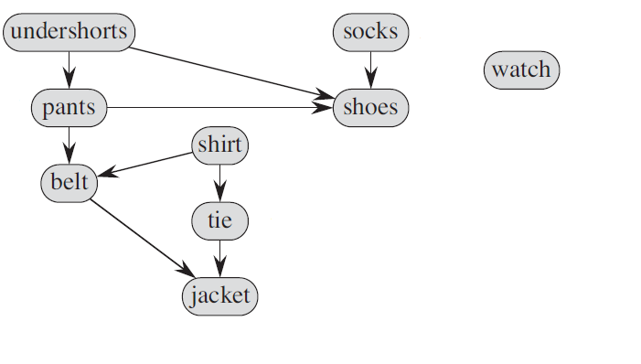
Topological Ordering

Slide 68
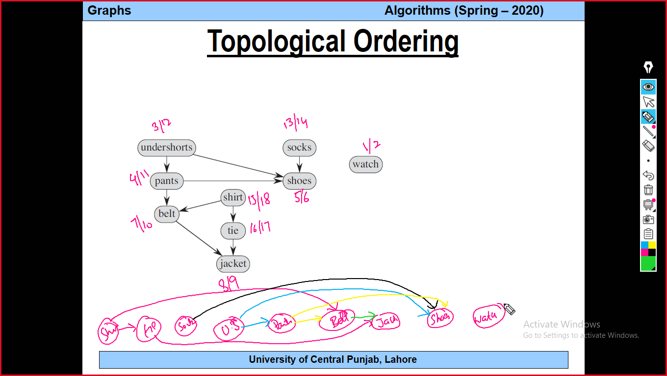

Slide 69
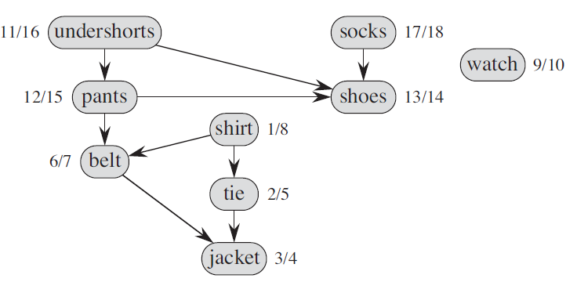
Topological Ordering

Slide 70
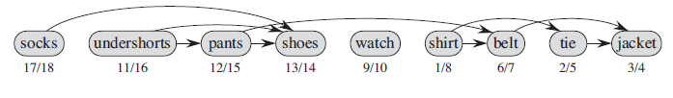
Topological Ordering/Topological Sort

Slide 71
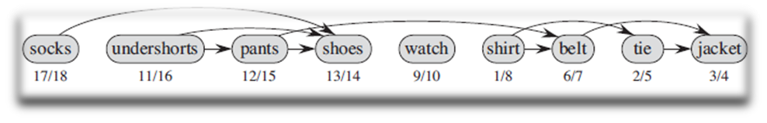
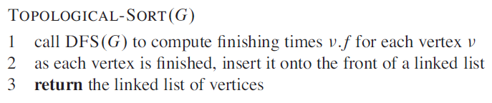
Topological Ordering/Topological Sort

Slide 72
How to get Edges back in Topological sort
You can use link list or stack for the vertices storage.
Process
[Mark all vertices as true]
Remove the top vertex from the stack mark as false
Get all its connected vertices from G, if connected vertex is marked true [means the vertex is still in the stack], add that edge in the new graph otherwise not to add that edge [this edge is the back edge that is pointing back to the parent]
Go to step 1, till stack is empty

Slide 73
Minimum Spanning Tree (MST)

Slide 74
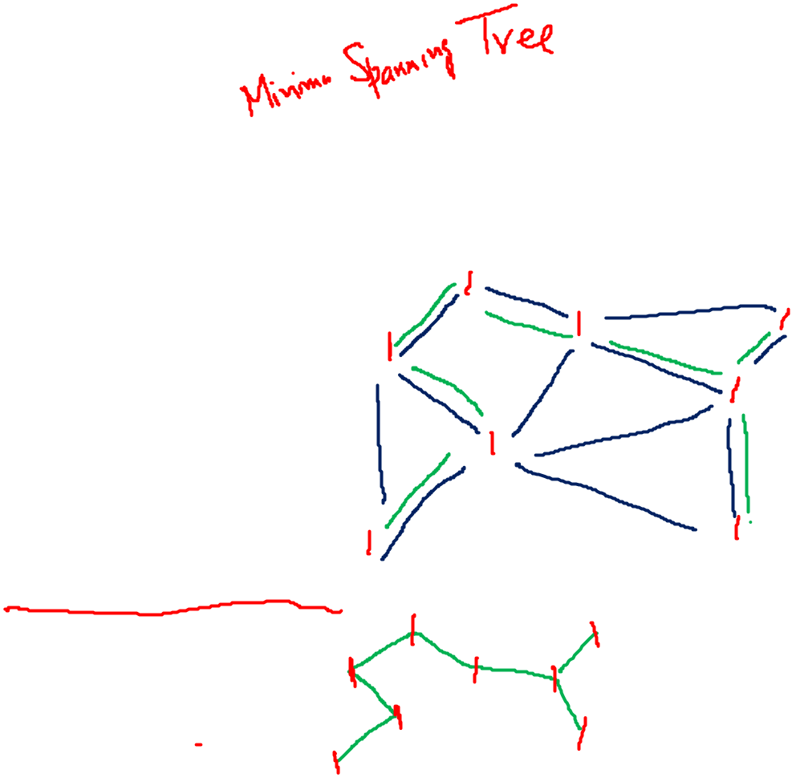
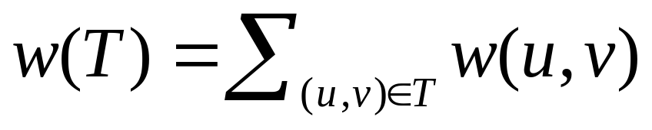
Motivation
For an electrical circuit certain pins have to be grounded. Finding the arrangement of wires (connecting those pins) that uses the least amount of wire.
Let a G(V,E) be a graph such that (u, v) ∈ E and a weight w(u,v) corresponding to wire needed to join u and v.
We are looking for an acyclic subset T ⊆ E that connects all vertices and whose total weight w(T) is minimized.

Slide 75
Motivation
Since T is acyclic and connects all the vertices, it must form a tree.
Since it spans the graph, it is called a spanning tree.
MST or actually means Minimum Weight Spanning Tree.

Slide 76
Minimum Spanning Tree
Problem: given a connected, undirected, weighted graph:
6
4
5
9
14
2
10
15
3
8

Slide 77
Minimum Spanning Tree
Problem: given a connected, undirected, weighted graph, find a spanning tree using edges that minimize the total weight
6
4
5
9
14
2
10
15
3
8

Slide 78
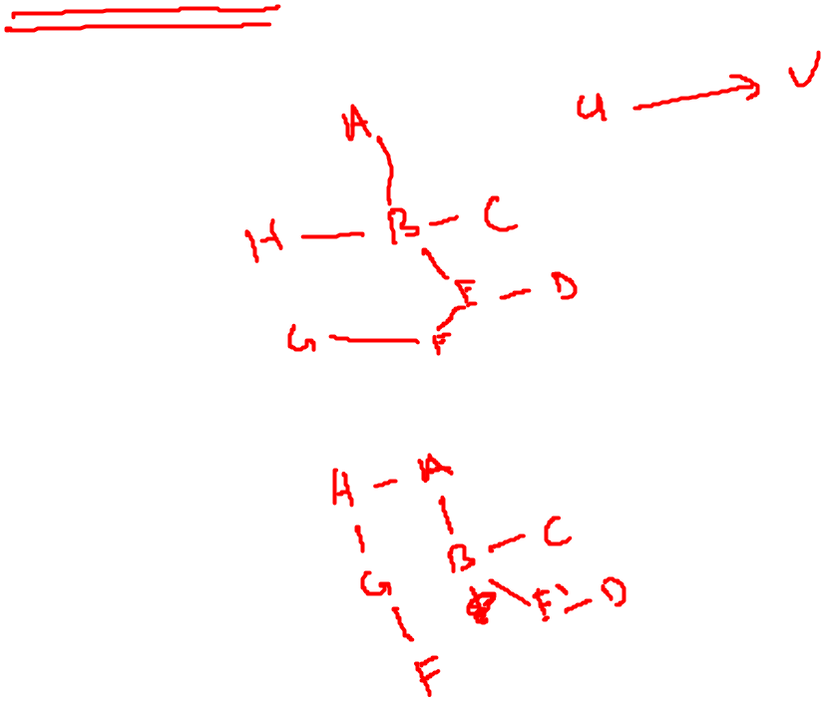
Minimum Spanning Tree
Which edges form the minimum spanning tree (MST) of the following graph?
A
6
4
H
5
B
9
C
14
2
10
G
E
15
D
3
8
F

Slide 79
Minimum Spanning Tree
Answer:
A
6
4
H
5
B
9
C
14
2
10
G
E
15
D
3
8
F

Slide 80
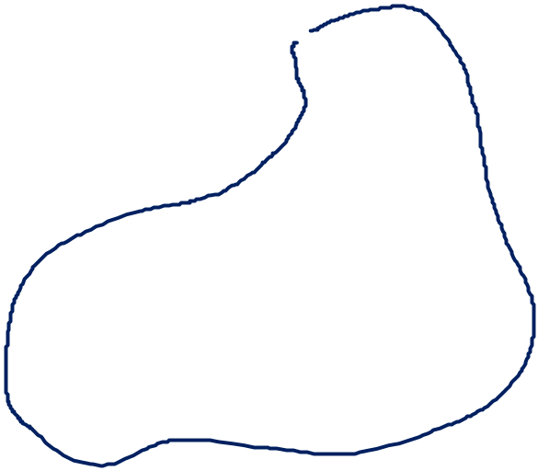
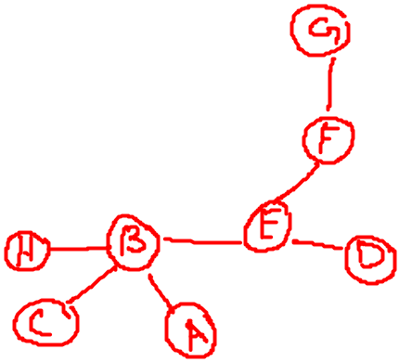
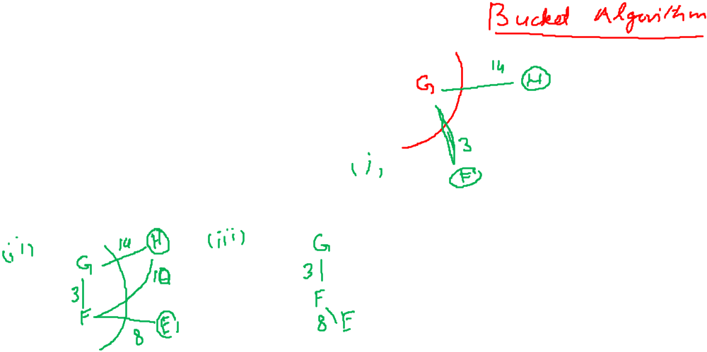
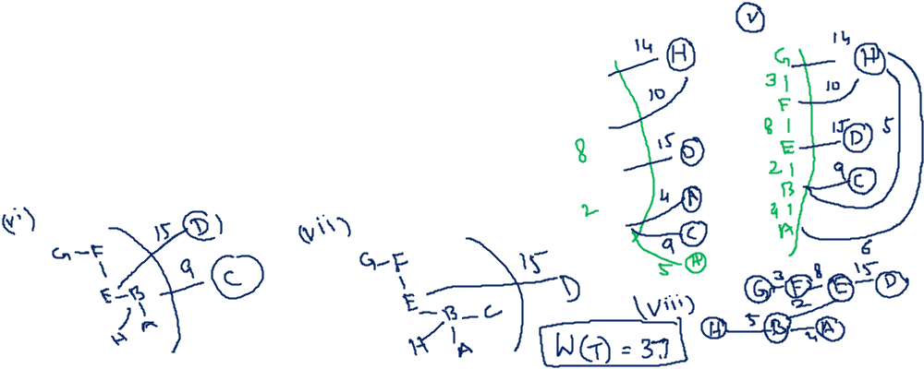
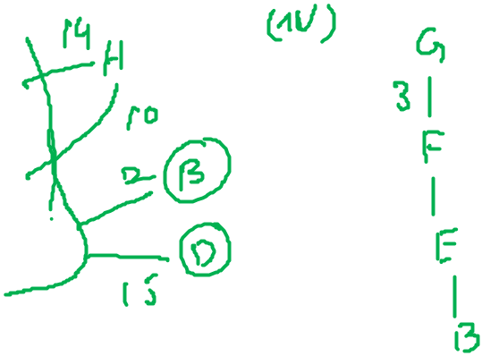
Minimum Spanning Tree
A
6
4
H
5
B
9
C
14
2
10
G
E
15
D
3
F
8

Slide 82
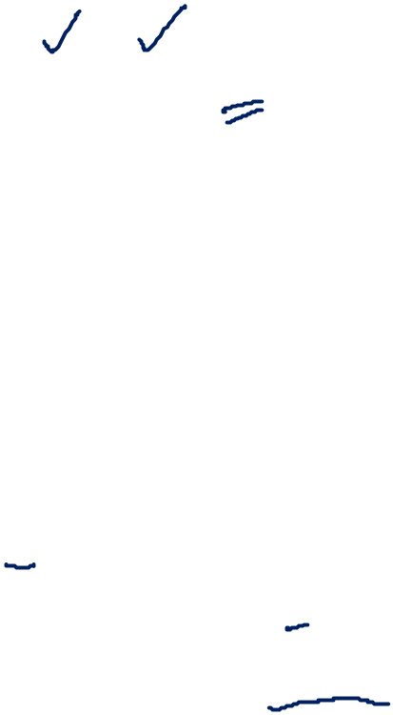
Prim’s Algorithm
MST-Prim(G, w, r)
Q = V[G];
for each u ∈ Q
key[u] = ∞;
key[r] = 0;
p[r] = NULL;
while (Q not empty)
u = ExtractMin(Q);
for each v ∈ Adj[u]
if (v ∈ Q and w(u,v) < key[v])
p[v] = u;
key[v] = w(u,v);

Slide 83
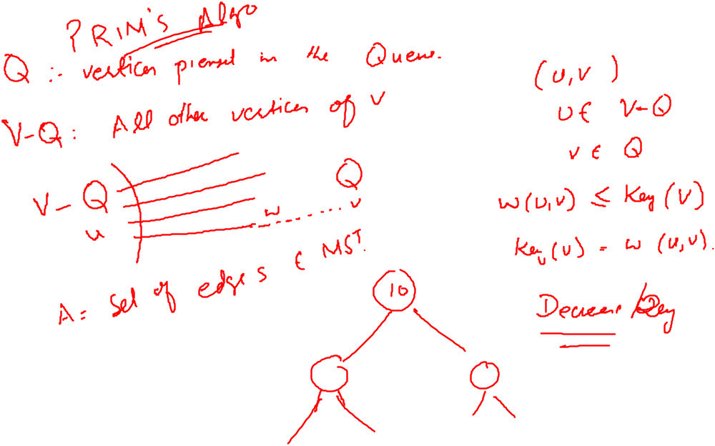

Slide 84
Prim’s Algorithm
MST-Prim(G, w, r)
Q = V[G];
for each u ∈ Q
key[u] = ∞;
key[r] = 0;
p[r] = NULL;
while (Q not empty)
u = ExtractMin(Q);
for each v ∈ Adj[u]
if (v ∈ Q and w(u,v) < key[v])
p[v] = u;
key[v] = w(u,v);
6
4
5
9
14
2
10
15
3
8
Run on example graph

Slide 85
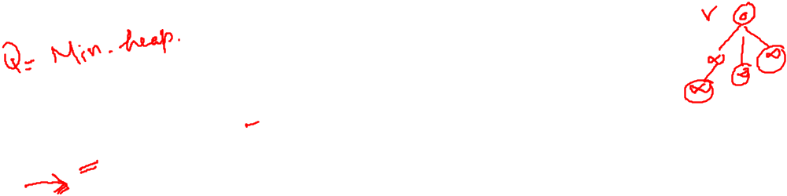

Prim’s Algorithm
MST-Prim(G, w, r)
Q = V[G];
for each u ∈ Q
key[u] = ∞;
key[r] = 0;
p[r] = NULL;
while (Q not empty)
u = ExtractMin(Q);
for each v ∈ Adj[u]
if (v ∈ Q and w(u,v) < key[v])
p[v] = u;
key[v] = w(u,v);
6
∞
4
5
9
∞
∞
∞
14
2
10
15
∞
∞
∞
3
∞
8
Run on example graph

Slide 86
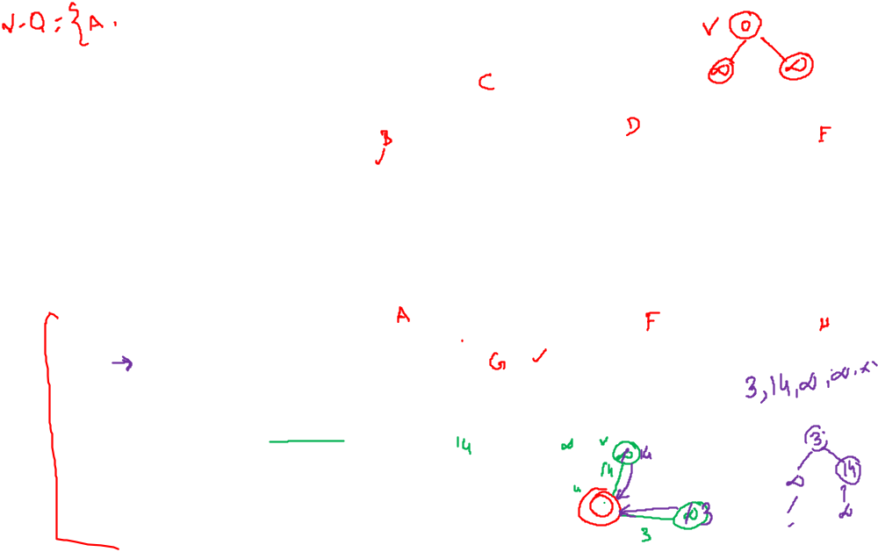
Prim’s Algorithm
MST-Prim(G, w, r)
Q = V[G];
for each u ∈ Q
key[u] = ∞;
key[r] = 0;
p[r] = NULL;
while (Q not empty)
u = ExtractMin(Q);
for each v ∈ Adj[u]
if (v ∈ Q and w(u,v) < key[v])
p[v] = u;
key[v] = w(u,v);
6
∞
4
5
9
∞
∞
∞
14
2
10
15
r
0
∞
∞
3
∞
8
Pick a start vertex r

Slide 87
Prim’s Algorithm
MST-Prim(G, w, r)
Q = V[G];
for each u ∈ Q
key[u] = ∞;
key[r] = 0;
p[r] = NULL;
while (Q not empty)
u = ExtractMin(Q);
for each v ∈ Adj[u]
if (v ∈ Q and w(u,v) < key[v])
p[v] = u;
key[v] = w(u,v);
6
∞
4
5
9
∞
∞
∞
14
2
10
15
u
0
∞
∞
3
∞
8
Red vertices have been removed from Q

Slide 88
Prim’s Algorithm
MST-Prim(G, w, r)
Q = V[G];
for each u ∈ Q
key[u] = ∞;
key[r] = 0;
p[r] = NULL;
while (Q not empty)
u = ExtractMin(Q);
for each v ∈ Adj[u]
if (v ∈ Q and w(u,v) < key[v])
p[v] = u;
key[v] = w(u,v);
6
∞
4
5
9
∞
∞
∞
14
2
10
15
u
0
∞
∞
3
3
8
Red arrows indicate parent pointers

Slide 89
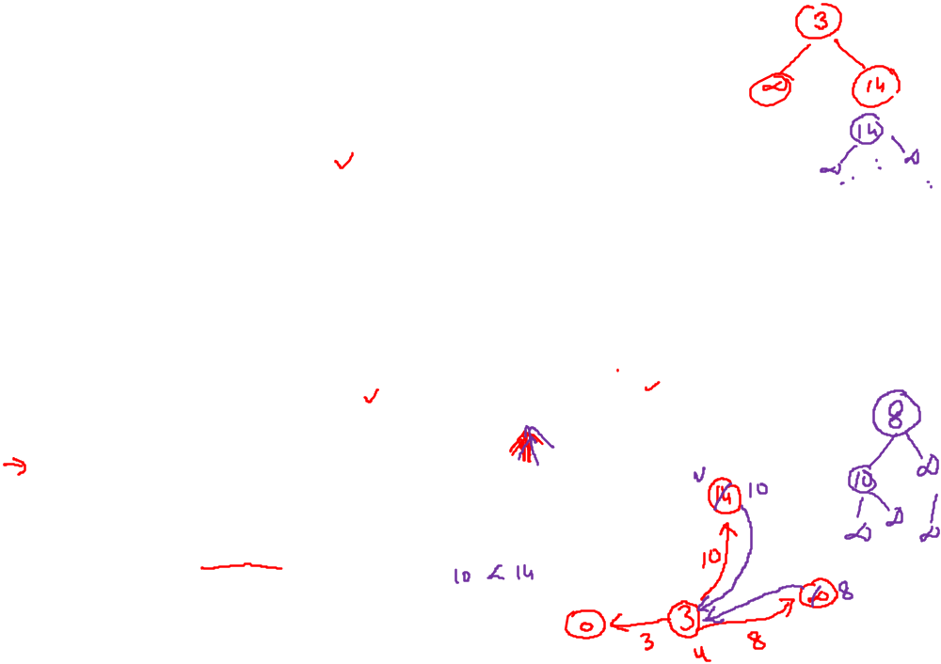
Prim’s Algorithm
MST-Prim(G, w, r)
Q = V[G];
for each u ∈ Q
key[u] = ∞;
key[r] = 0;
p[r] = NULL;
while (Q not empty)
u = ExtractMin(Q);
for each v ∈ Adj[u]
if (v ∈ Q and w(u,v) < key[v])
p[v] = u;
key[v] = w(u,v);
6
∞
4
5
9
14
∞
∞
14
2
10
15
u
0
∞
∞
3
3
8

Slide 90
Prim’s Algorithm
MST-Prim(G, w, r)
Q = V[G];
for each u ∈ Q
key[u] = ∞;
key[r] = 0;
p[r] = NULL;
while (Q not empty)
u = ExtractMin(Q);
for each v ∈ Adj[u]
if (v ∈ Q and w(u,v) < key[v])
p[v] = u;
key[v] = w(u,v);
6
∞
4
5
9
14
∞
∞
14
2
10
15
0
∞
∞
3
3
8
u

Slide 91
Prim’s Algorithm
MST-Prim(G, w, r)
Q = V[G];
for each u ∈ Q
key[u] = ∞;
key[r] = 0;
p[r] = NULL;
while (Q not empty)
u = ExtractMin(Q);
for each v ∈ Adj[u]
if (v ∈ Q and w(u,v) < key[v])
p[v] = u;
key[v] = w(u,v);
6
∞
4
5
9
14
∞
∞
14
2
10
15
0
8
∞
3
3
8
u

Slide 92


Prim’s Algorithm
MST-Prim(G, w, r)
Q = V[G];
for each u ∈ Q
key[u] = ∞;
key[r] = 0;
p[r] = NULL;
while (Q not empty)
u = ExtractMin(Q);
for each v ∈ Adj[u]
if (v ∈ Q and w(u,v) < key[v])
p[v] = u;
key[v] = w(u,v);
6
∞
4
5
9
10
∞
∞
14
2
10
15
0
8
∞
3
3
8
u

Slide 93
Prim’s Algorithm
MST-Prim(G, w, r)
Q = V[G];
for each u ∈ Q
key[u] = ∞;
key[r] = 0;
p[r] = NULL;
while (Q not empty)
u = ExtractMin(Q);
for each v ∈ Adj[u]
if (v ∈ Q and w(u,v) < key[v])
p[v] = u;
key[v] = w(u,v);
6
∞
4
5
9
10
∞
∞
14
2
10
15
0
8
∞
3
3
8
u

Slide 94
Prim’s Algorithm
MST-Prim(G, w, r)
Q = V[G];
for each u ∈ Q
key[u] = ∞;
key[r] = 0;
p[r] = NULL;
while (Q not empty)
u = ExtractMin(Q);
for each v ∈ Adj[u]
if (v ∈ Q and w(u,v) < key[v])
p[v] = u;
key[v] = w(u,v);
6
∞
4
5
9
10
2
∞
14
2
10
15
0
8
∞
3
3
8
u

Slide 95
Prim’s Algorithm
MST-Prim(G, w, r)
Q = V[G];
for each u ∈ Q
key[u] = ∞;
key[r] = 0;
p[r] = NULL;
while (Q not empty)
u = ExtractMin(Q);
for each v ∈ Adj[u]
if (v ∈ Q and w(u,v) < key[v])
p[v] = u;
key[v] = w(u,v);
6
∞
4
5
9
10
2
∞
14
2
10
15
0
8
15
3
3
8
u

Slide 96
Prim’s Algorithm
u
MST-Prim(G, w, r)
Q = V[G];
for each u ∈ Q
key[u] = ∞;
key[r] = 0;
p[r] = NULL;
while (Q not empty)
u = ExtractMin(Q);
for each v ∈ Adj[u]
if (v ∈ Q and w(u,v) < key[v])
p[v] = u;
key[v] = w(u,v);
6
∞
4
5
9
10
2
∞
14
2
10
15
0
8
15
3
3
8

Slide 97
Prim’s Algorithm
u
MST-Prim(G, w, r)
Q = V[G];
for each u ∈ Q
key[u] = ∞;
key[r] = 0;
p[r] = NULL;
while (Q not empty)
u = ExtractMin(Q);
for each v ∈ Adj[u]
if (v ∈ Q and w(u,v) < key[v])
p[v] = u;
key[v] = w(u,v);
6
4
4
5
9
10
2
∞
14
2
10
15
0
8
15
3
3
8

Slide 98
Prim’s Algorithm
u
MST-Prim(G, w, r)
Q = V[G];
for each u ∈ Q
key[u] = ∞;
key[r] = 0;
p[r] = NULL;
while (Q not empty)
u = ExtractMin(Q);
for each v ∈ Adj[u]
if (v ∈ Q and w(u,v) < key[v])
p[v] = u;
key[v] = w(u,v);
6
4
4
5
9
5
2
∞
14
2
10
15
0
8
15
3
3
8

Slide 99
Prim’s Algorithm
u
MST-Prim(G, w, r)
Q = V[G];
for each u ∈ Q
key[u] = ∞;
key[r] = 0;
p[r] = NULL;
while (Q not empty)
u = ExtractMin(Q);
for each v ∈ Adj[u]
if (v ∈ Q and w(u,v) < key[v])
p[v] = u;
key[v] = w(u,v);
6
4
4
5
9
5
2
9
14
2
10
15
0
8
15
3
3
8

Slide 100
Prim’s Algorithm
u
MST-Prim(G, w, r)
Q = V[G];
for each u ∈ Q
key[u] = ∞;
key[r] = 0;
p[r] = NULL;
while (Q not empty)
u = ExtractMin(Q);
for each v ∈ Adj[u]
if (v ∈ Q and w(u,v) < key[v])
p[v] = u;
key[v] = w(u,v);
6
4
4
5
9
5
2
9
14
2
10
15
0
8
15
3
3
8

Slide 101
Prim’s Algorithm
u
MST-Prim(G, w, r)
Q = V[G];
for each u ∈ Q
key[u] = ∞;
key[r] = 0;
p[r] = NULL;
while (Q not empty)
u = ExtractMin(Q);
for each v ∈ Adj[u]
if (v ∈ Q and w(u,v) < key[v])
p[v] = u;
key[v] = w(u,v);
6
4
4
5
9
5
2
9
14
2
10
15
0
8
15
3
3
8

Slide 102
Prim’s Algorithm
u
MST-Prim(G, w, r)
Q = V[G];
for each u ∈ Q
key[u] = ∞;
key[r] = 0;
p[r] = NULL;
while (Q not empty)
u = ExtractMin(Q);
for each v ∈ Adj[u]
if (v ∈ Q and w(u,v) < key[v])
p[v] = u;
key[v] = w(u,v);
6
4
4
5
9
5
2
9
14
2
10
15
0
8
15
3
3
8

Slide 103

Prim’s Algorithm
MST-Prim(G, w, r)
Q = V[G];
for each u ∈ Q
key[u] = ∞;
key[r] = 0;
p[r] = NULL;
while (Q not empty)
u = ExtractMin(Q);
for each v ∈ Adj[u]
if (v ∈ Q and w(u,v) < key[v])
p[v] = u;
key[v] = w(u,v);
6
4
4
5
9
5
2
9
14
2
u
10
15
0
8
15
3
3
8

Slide 104

Review: Prim’s Algorithm
MST-Prim(G, w, r)
Q = V[G];
for each u ∈ Q
key[u] = ∞;
key[r] = 0;
p[r] = NULL;
while (Q not empty)
u = ExtractMin(Q);
for each v ∈ Adj[u]
if (v ∈ Q and w(u,v) < key[v])
p[v] = u;
key[v] = w(u,v);
What is the hidden cost in this code?

Slide 105

Review: Prim’s Algorithm
MST-Prim(G, w, r)
Q = V[G];
for each u ∈ Q
key[u] = ∞;
key[r] = 0;
p[r] = NULL;
while (Q not empty)
u = ExtractMin(Q);
for each v ∈ Adj[u]
if (v ∈ Q and w(u,v) < key[v])
p[v] = u;
DecreaseKey(v, w(u,v));

Slide 106
Review: Prim’s Algorithm
MST-Prim(G, w, r)
Q = V[G];
for each u ∈ Q
key[u] = ∞;
key[r] = 0;
p[r] = NULL;
while (Q not empty)
u = ExtractMin(Q);
for each v ∈ Adj[u]
if (v ∈ Q and w(u,v) < key[v])
p[v] = u;
DecreaseKey(v, w(u,v));
How often is ExtractMin() called?
How often is DecreaseKey() called?

Slide 107

Review: Prim’s Algorithm
MST-Prim(G, w, r)
Q = V[G];
for each u ∈ Q
key[u] = ∞;
key[r] = 0;
p[r] = NULL;
while (Q not empty)
u = ExtractMin(Q);
for each v ∈ Adj[u]
if (v ∈ Q and w(u,v) < key[v])
p[v] = u;
key[v] = w(u,v);
What will be the running time?
A: Depends on queue
binary heap: O(E lg V)
Fibonacci heap: O(V lg V + E)

Slide 108

Kruskal’s Algo for MST
6
4
5
9
14
2
10
MST-KRUSKAL(G,w)
A=NULL
for each vertex v ∈ V[G]
Make-Set(v)
sort the edges(E) in increasing order by weight w
for each edge (u,v) ∈ E
if FindSet(u) ≠ FindSet(v)
A=A U {(u,v)}
UNUION(u,v)
15
3
8

Slide 109

Kruskal’s Algo for MST
6
4
5
9
14
2
10
15
3
8

Slide 110



Slide 111


Slide 112
Some Good Questions
Write a C program to return the n^{th} node from the end of a linked list.
Delete a node efficiently from a singly linked list, you have only two pointers i.e. address of head node and address of node to be deleted
How to create three dimensional dynamic arrays?
How to determine if there is memory leak in the program? Assume memory is allocated by new operator and released using delete operator.

